Slide 1
Introduction to Microeconomics

Slide 2
Lecture 15 Production and Costs

Slide 3
Production and Costs
Economic Concepts of Cost
Certainly, a cost is incurred whenever a fixed input or variable input is employed in the production process.
The costs associated with fixed inputs are called fixed costs. The costs associated with variable inputs are called variable costs.
Fixed costs are the costs that do not vary with output; whereas the variable costs are the costs that vary with output.

Slide 4
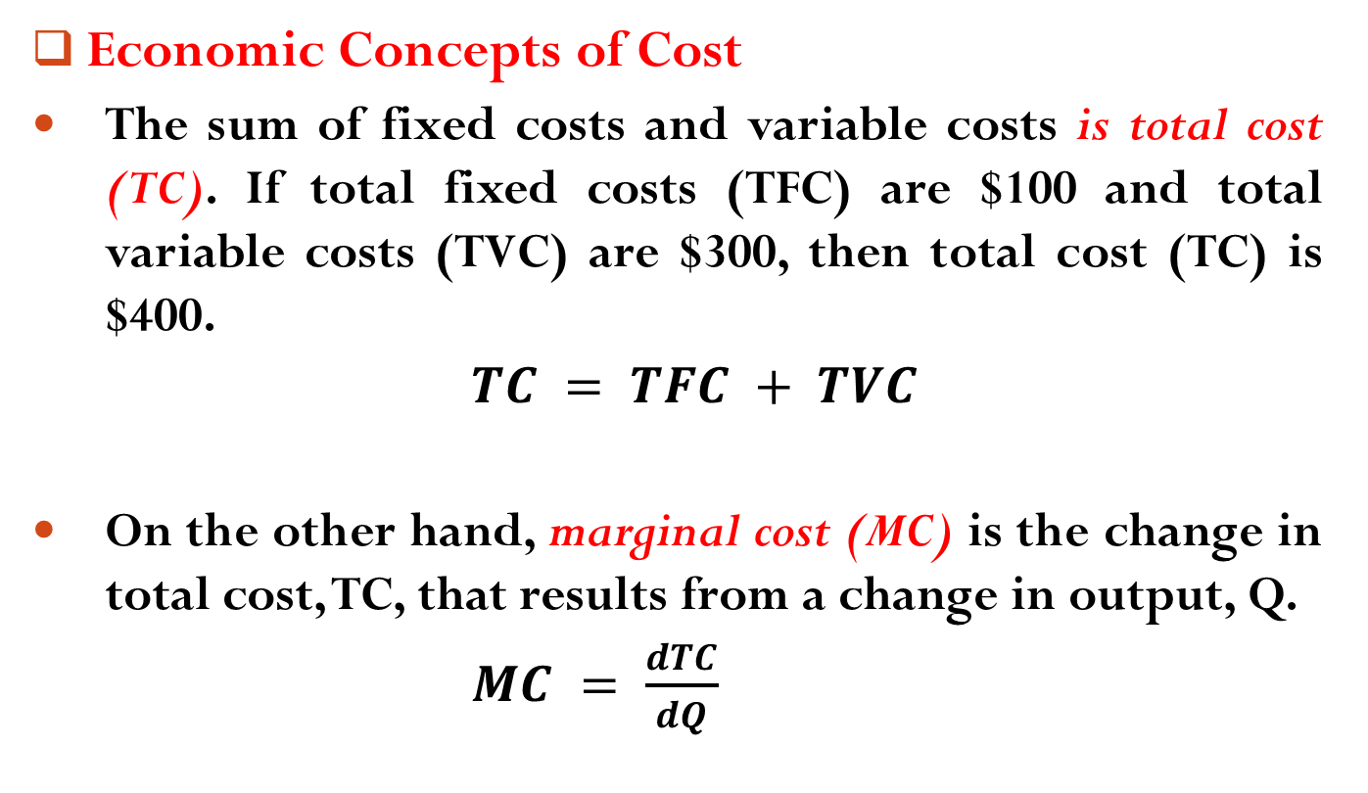
Production and Costs
Economic Concepts of Cost
The sum of fixed costs and variable costs is total cost (TC). If total fixed costs (TFC) are $100 and total variable costs (TVC) are $300, then total cost (TC) is $400.
$TC = TFC + TVC$
On the other hand, marginal cost (MC) is the change in total cost, TC, that results from a change in output, Q.
$MC = \frac{dTC}{dQ}$

Slide 5

Production and Costs
Economic Concepts of Cost
Finally, average cost (AC) is the total cost divided by quantity of output.
$AC = TC/Q$

Slide 6
Production and Costs
The Link between MPP And MC
The marginal cost (MC) of producing a good is a reflection of the marginal physical product (MPP) of the variable input.
In Exhibit 3, the link between the marginal physical product of a variable input and marginal cost is established.

Slide 7
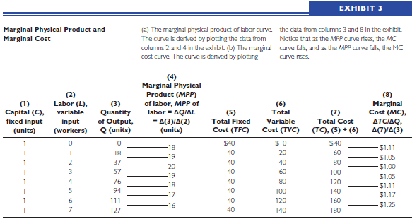
Production and Costs
The Link between MPP And MC

Slide 8
Production and Costs
The Link between MPP And MC
In the exhibit, column 3 shows the different quantities of output produced by 1 unit of capital (fixed input) and various amounts of labor (variable input), and column 4 shows the MPP of labor.
Exhibit 3(a) shows the MPP curve, which is based on the data in column 4.
Notice that the MPP curve first rises and then falls.

Slide 9
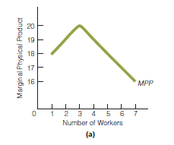
Production and Costs
The Link between MPP And MC

Slide 10
Production and Costs
The Link between MPP And MC
In column 5, we have identified the total fixed cost (TFC) of production as $40.
For column 6, we have assumed that each worker is hired for $20; so when there is only 1 worker, total variable cost (TVC) is $20; when there are 2 workers, total variable cost is $40; and so on.
Column 7 shows total cost at various output levels; the total cost figures in this column are simply the sum of the fixed costs in column 5 and the variable costs in column 6.

Slide 11
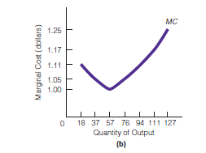
Production and Costs
The Link between MPP And MC
Finally, in column 8, we compute marginal cost. Exhibit 3(b) shows the MC curve, which is based on the data in column 8.

Slide 12
Production and Costs
The Link between MPP And MC
Columns 4 and 8 show the MPP and MC, respectively.
Notice that when the MPP is rising (from 18 to 19 to 20), marginal cost is decreasing (from $1.11 to $1.05 to $1.00), and when the MPP is falling (from 20 to 19, etc.), marginal cost is increasing (from $1.00 to $1.05, etc.).
In other words, the MPP and MC move in opposite directions.

Slide 13
Production and Costs
The Link between MPP And MC
We can also see this by comparing the MPP curve with the MC curve.
When the MPP curve is going up, the MC curve is moving down, and when the MPP curve is going down, the MC curve is going up.
In conclusion, then, what the MC curve looks like depends on what the MPP curve looks like.

Slide 14
Production and Costs
The Link between MPP And MC
Recall that the MPP curve must have a declining portion because of the law of diminishing marginal returns.
So if the MPP curve first rises and then (when diminishing marginal returns set in) falls, the MC curve must first fall and then rise.

Slide 15
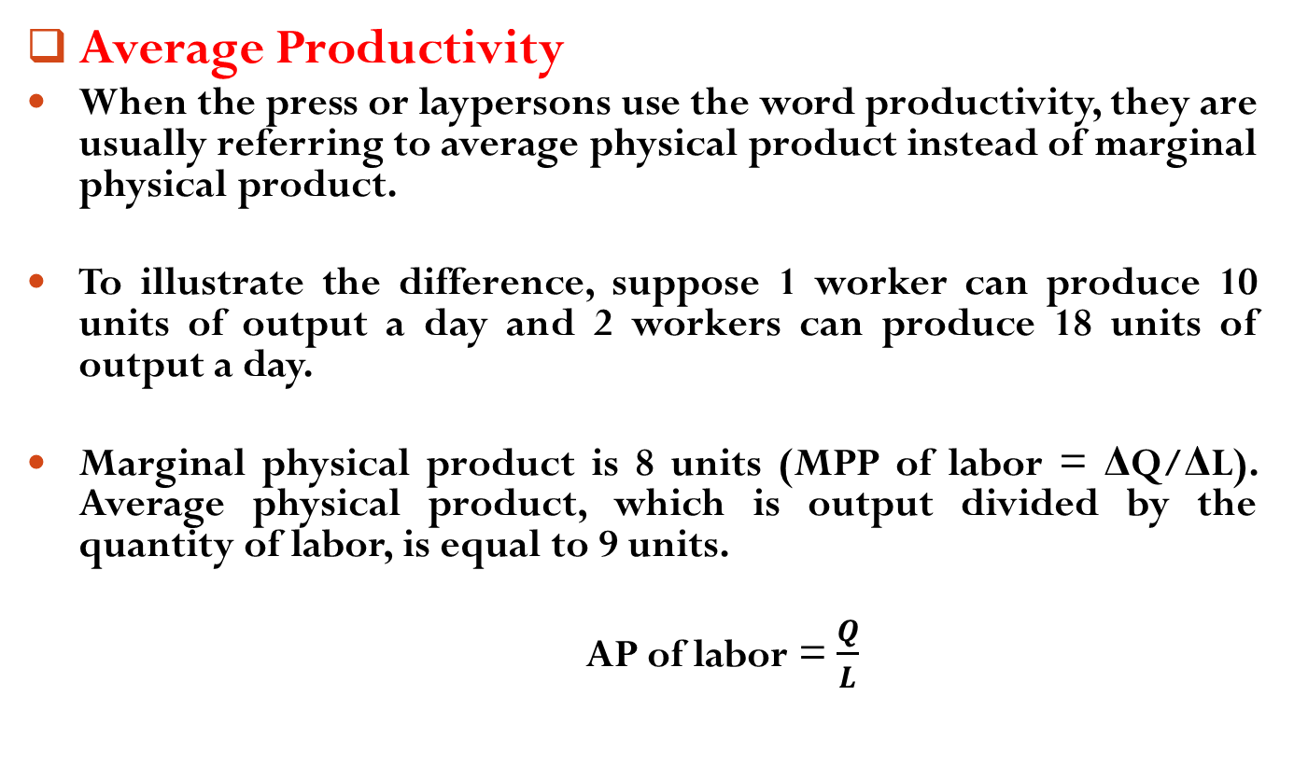
Production and Costs
Average Productivity
When the press or laypersons use the word productivity, they are usually referring to average physical product instead of marginal physical product.
To illustrate the difference, suppose 1 worker can produce 10 units of output a day and 2 workers can produce 18 units of output a day.
Marginal physical product is 8 units (MPP of labor = ΔQ/ΔL). Average physical product, which is output divided by the quantity of labor, is equal to 9 units.
AP of labor = $\frac{Q}{L}$

Slide 16
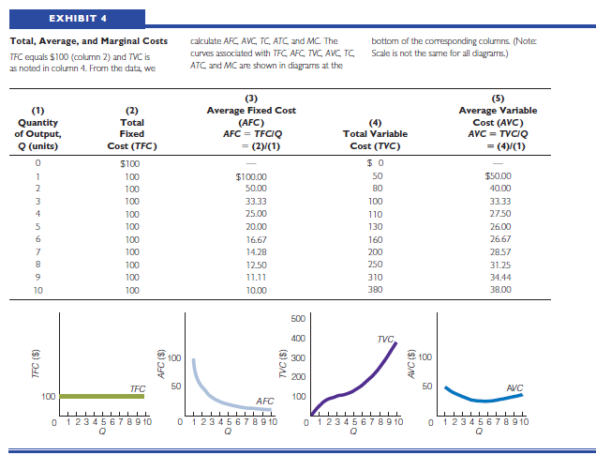
Production and Costs
Costs of Production: Total, Average, Marginal

Slide 17
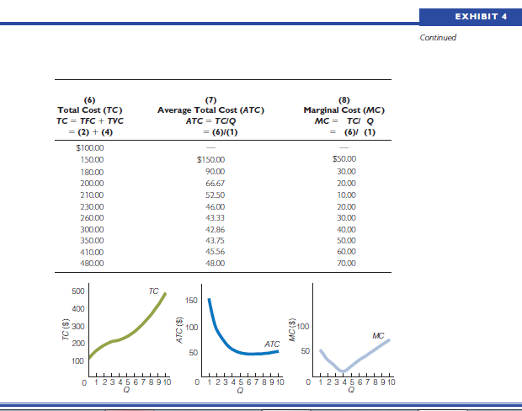
Production and Costs
Costs of Production: Total, Average, Marginal

Slide 18
Production and Costs
Shifts in Cost Curves
There are some factors which cause cost curve to shift. They are,
Taxes
Input Prices
Technology

Slide 19
Readings
Roger A. Arnold- Microeconomics, 10th Edition, Chapter – 8.

Slide 20


Slide 21
Thank You

